Slide 1
PHISHING
AWARENESS TRAINING

Slide 2
WHAT IS PHISHING ?
Phishing is a commonly used cyberattack technique used in an attempt to obtain sensitive information such as usernames, passwords, and credit card details of a target by disguising as a trustworthy entity in an electronic communication.
Phishing is a dangerous digital deception that target both Individuals and Organizations.

Slide 3
How Phishing works
Attackers usually try to convince the target to click on certain links which will then enable the attacker to gain access of sensitive information from the target’s device.
This is done through a process known as Social Engineering, where an attacker may pose as a legitimate company, bank or trusted individual.
Attackers send emails, texts or messages containing malicious links or attachments that when clicked or opened by the victim their information gets compromised.

Slide 4
Types of Phishing Attacks
General phishing attack, where attacker send information to anybody to see who responds and adds them to their “target scope”.
Spear phishing attack, an attack where the attacker crafts a message that is specific to an individual or organization with the motive of deceiving the victim to obtain their sensitive information like bank records and employment information.
Vishing attack, a phishing through voice calls either voicemail or phone.

Slide 5
Types of Phishing Attacks
Whaling attacks, carried out on high-profiled individuals like CEOs or executives who have access to a lot of information and administrative access. Message contains a lot of details to increase it’s effectiveness.
SEO poisoning, an attacker puts up a fake website and tricks the search engine to show it on top list of searches of the domain name.
Smishing attack, a phishing attack carried out through sms text messages.

Slide 6
Examples of Phishing Attacks
Fake emails from banks or financial institutions requesting account verification.
Emails claiming to be from popular online services with password reset requests.
Malicious links embedded in social media posts or messages.

Slide 7
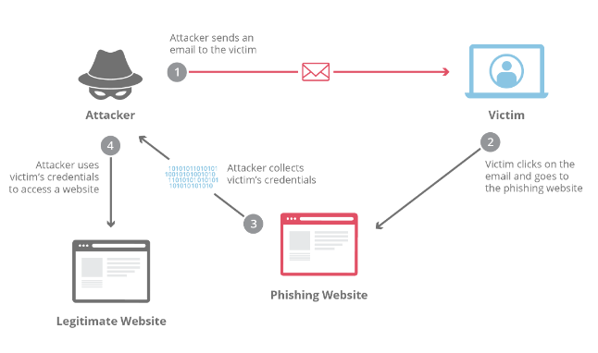
Phishing Attack

Slide 8
How to Protect Yourself
VIGILANCE
AVOID CLICKING LINKS
Be cautious of unsolicited emails, texts, or calls asking for personal information.
If it’s too good to be true, it probably is, avoid it.
You probably didn’t win free money! or Your account may be deactivated but there is an alternative way of confirming this than clicking on a link.
You can hover over links to see the actual URL before clicking.
Avoid clicking links that you are uncertain about.
Verify sender of a link before clicking on the link, check the email address or phone number for any inconsistencies or typos.

Slide 9
How to Protect Yourself
ENABLE TWO-FACTOR AUTHENTICATION
KEEP SOFTWARE UPDATED
Add an extra layer of security to your account.
Makes them more secure and hard to gain access to without authorization.
Ensure your devices and software have the latest security patches.
This makes it hard for attackers to exploit victim with the old known methods.

Slide 10
How to Protect Yourself
INSTALL ANTI-VIRUS
EMAIL SCRUBBER
Installing anti-virus software on a device reduce the chances of the device being infiltrated by malicious programs.
Endpoint Detection and Response software can also be used to keep data on a device secure.
Using email security programs that scrub your emails looking for links to known phishing sites.

Slide 11
How to Protect Yourself
SECURE DNS
Using a secure domain name server is essential as it may already have a list of known phishing, malware and hacker websites that when clicked upon it denies opening the malicious link keeping you safe.
Quad 9 is a free secure DNS tool for protection.

Slide 12
Thank You.

